Slide 1
V20180313

Slide 2
Confucius (551-479 BC)
If your plan is for 1 year then plant rice

Slide 3
Confucius (551-479 BC)
If your plan is for 1 year then plant rice
If your plan is for 10 years then plant trees

Slide 4
Confucius (551-479 BC)
If your plan is for 1 year then plant rice
If your plan is for 10 years then plant trees
If your plan is for 100 years then educate children

Slide 6
Data
Analysis
Data
Collection
Data
Management

Slide 7
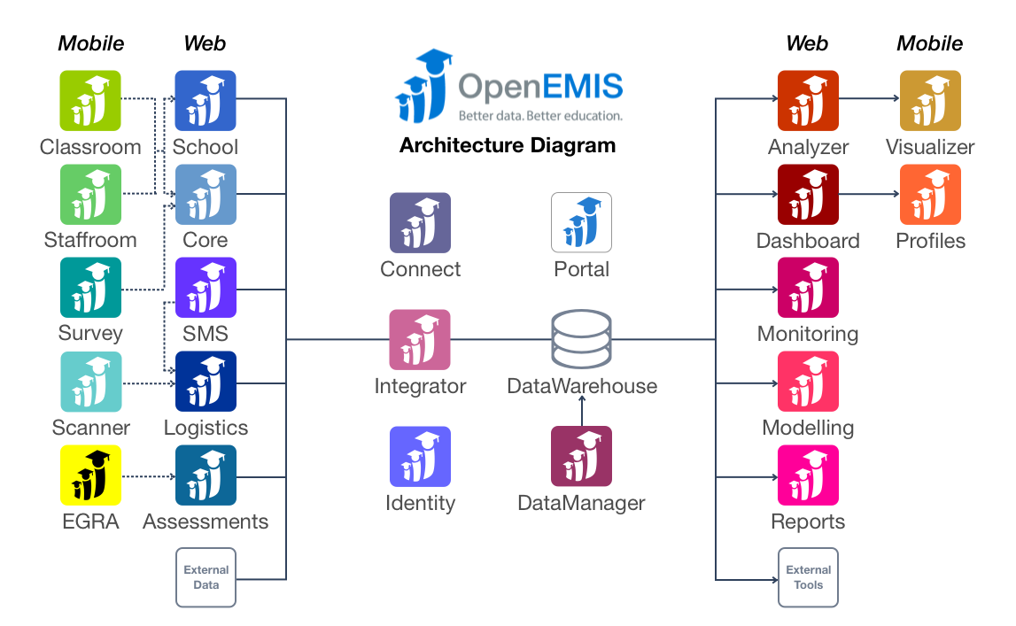

Slide 8
Data Collection
OpenEMIS
SMS
OpenEMIS
Survey
OpenEMIS
Classroom
OpenEMIS
Core

Slide 9
OpenEMIS SMS
1 message received
Show

Slide 10
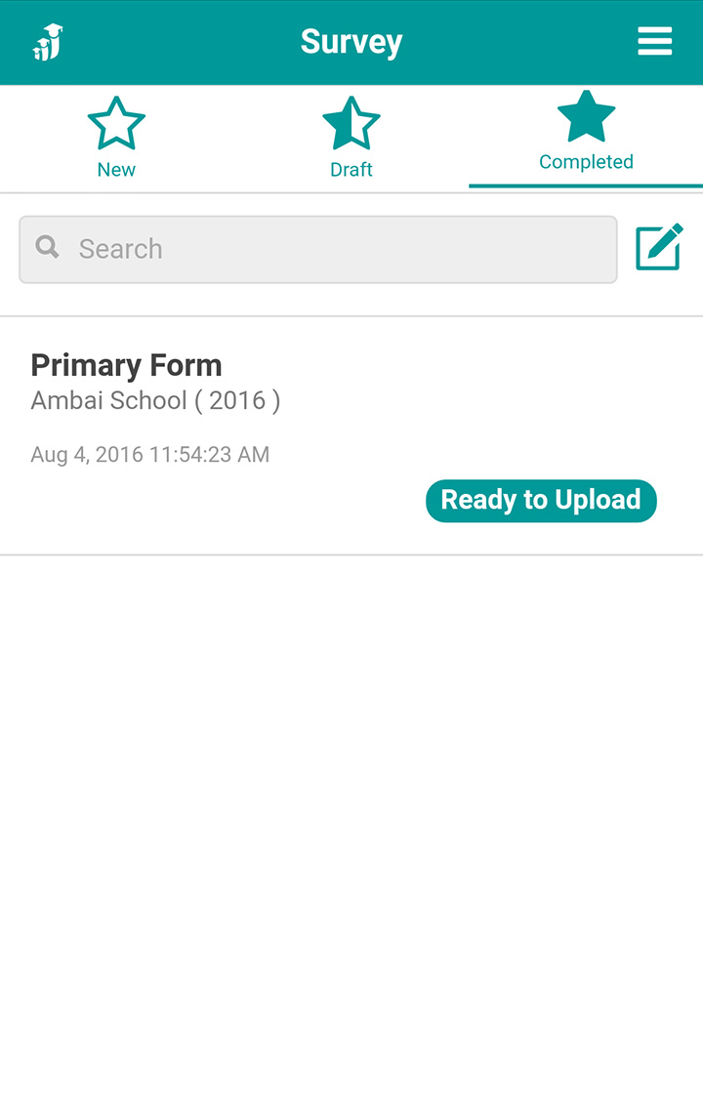
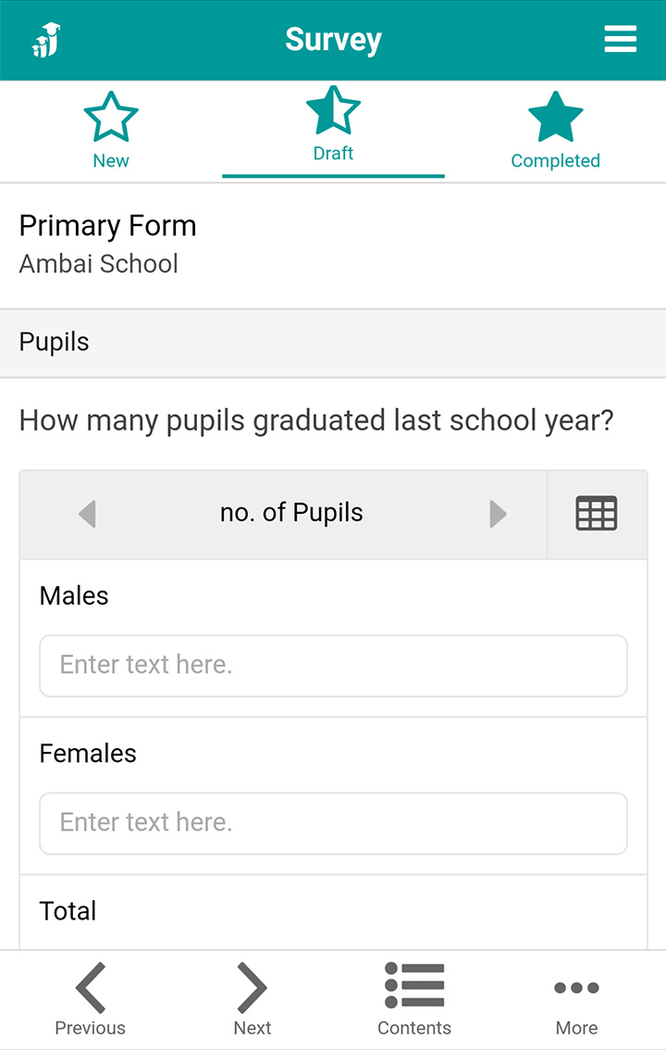
OpenEMIS Survey

Slide 11
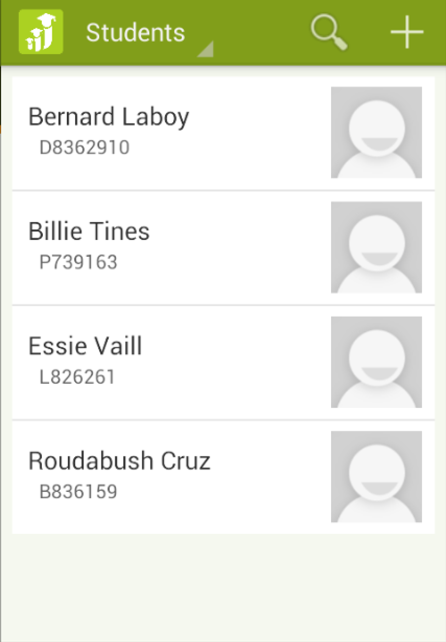
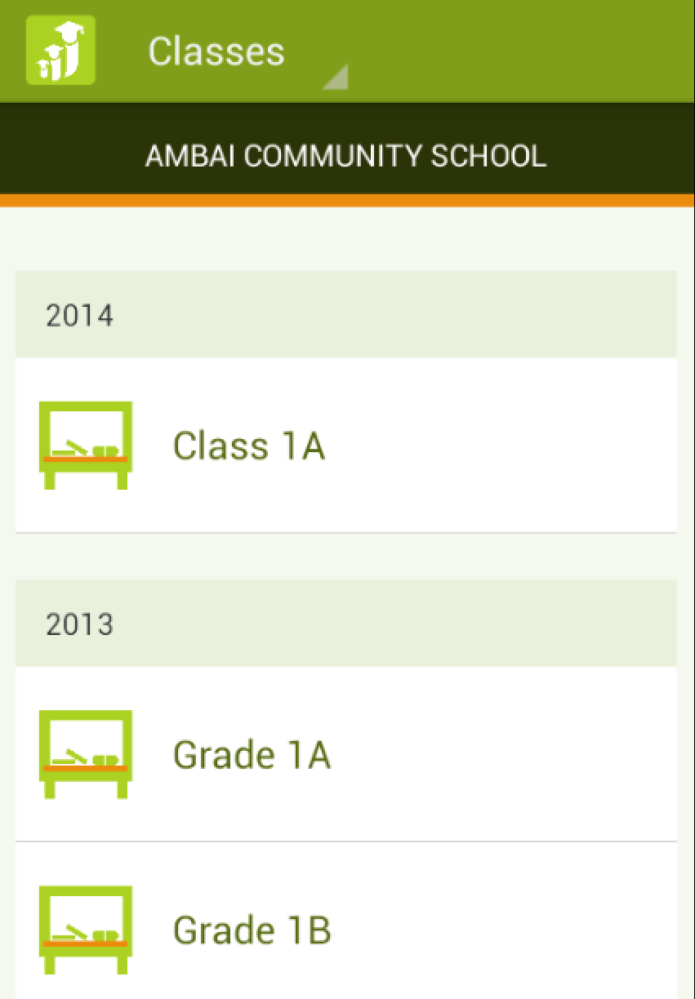
OpenEMIS Classroom

Slide 12
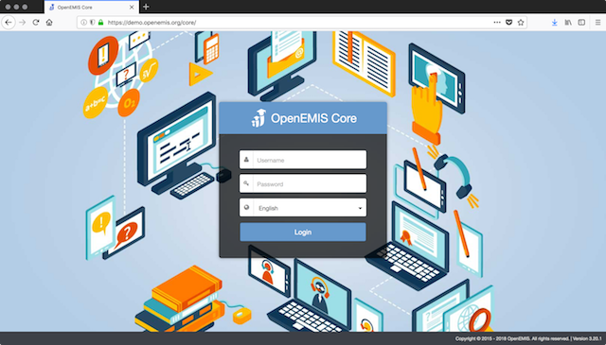
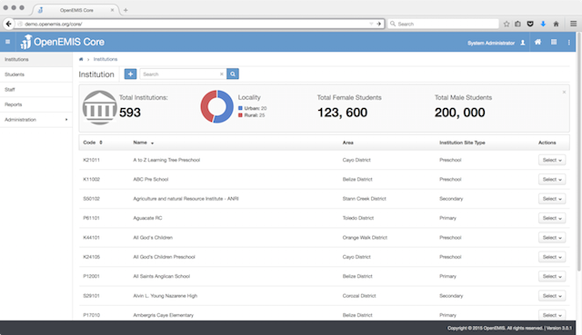
OpenEMIS Core

Slide 13
Data Collection
Data Management

Slide 14
Data Management
OpenEMIS
DataManager
OpenEMIS
Integrator

Slide 15
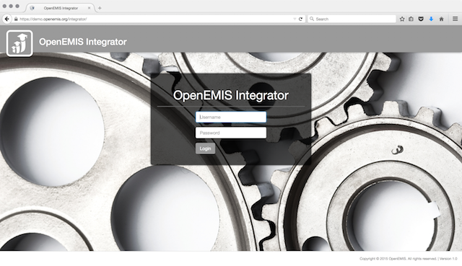
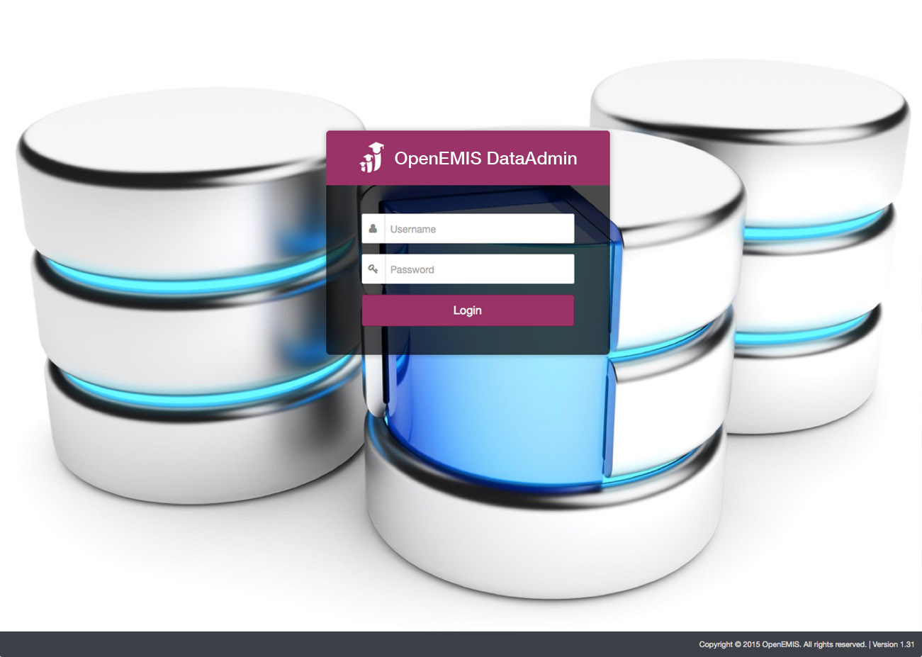
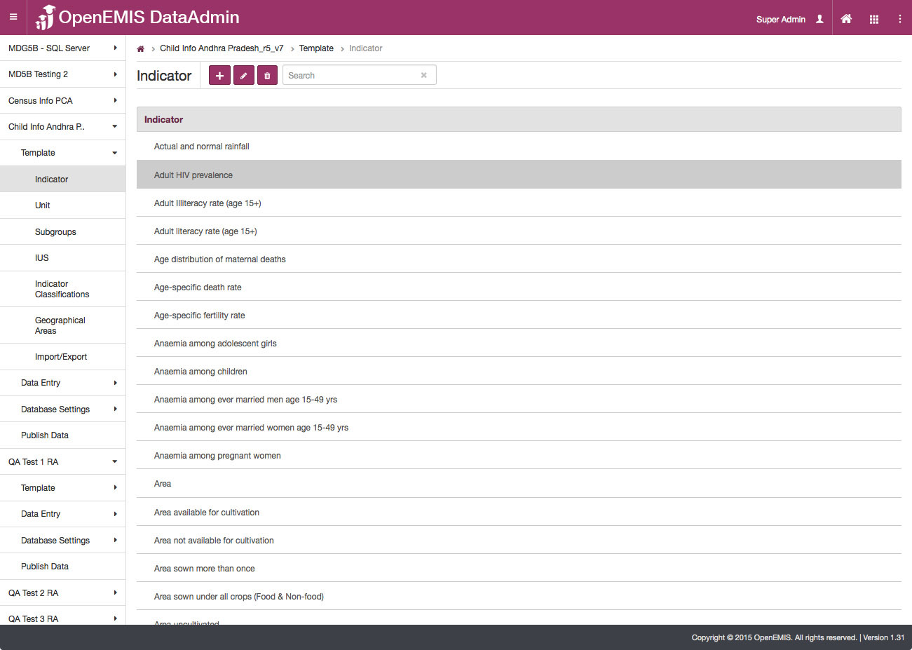
OpenEMIS DataManager

Slide 16
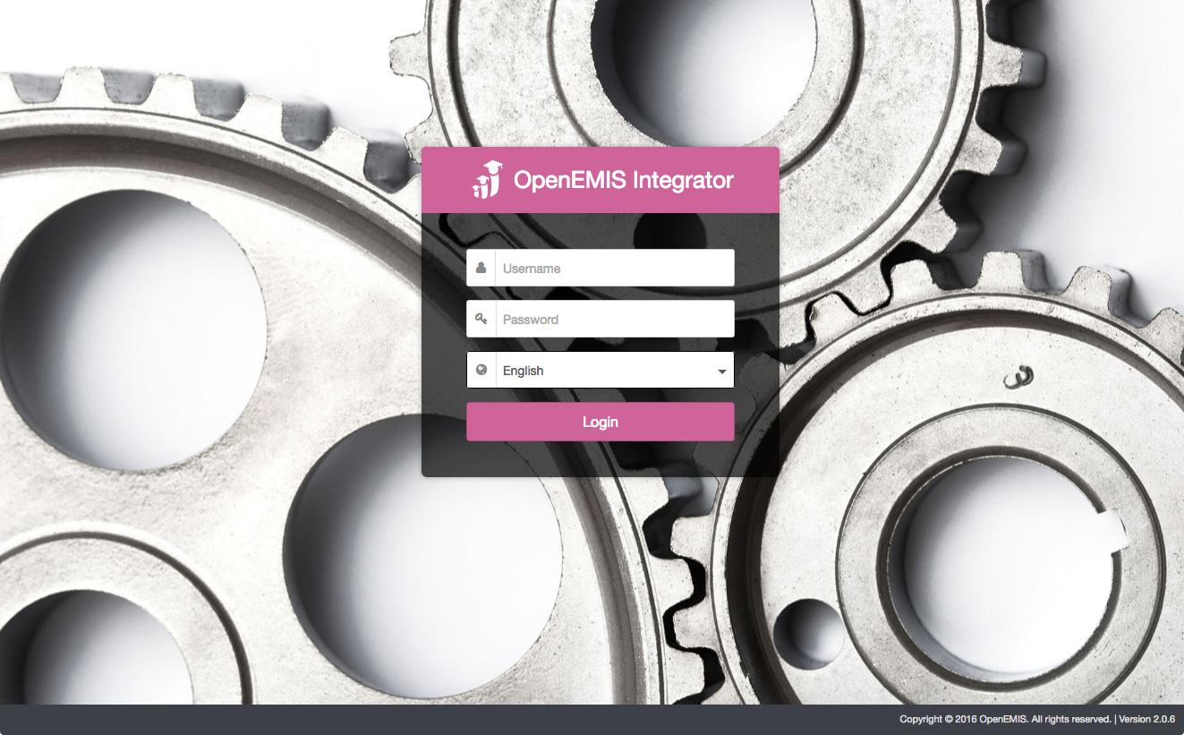
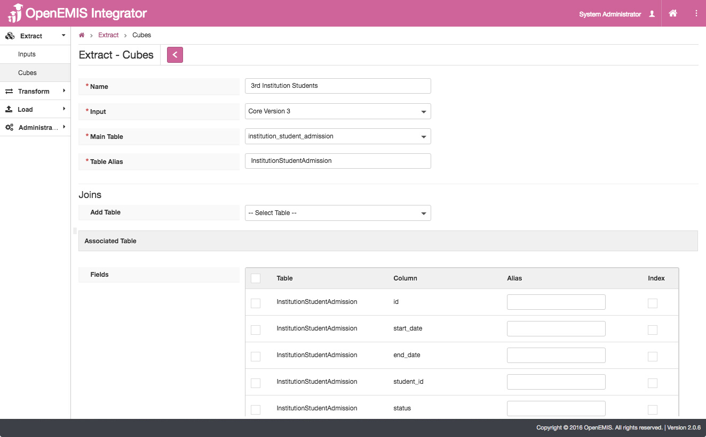
OpenEMIS Integrator

Slide 17
Data Management
Data Analysis

Slide 18
Data Analysis
OpenEMIS
Dashboard
OpenEMIS
Profiles
OpenEMIS
Visualizer
OpenEMIS
Monitoring

Slide 19
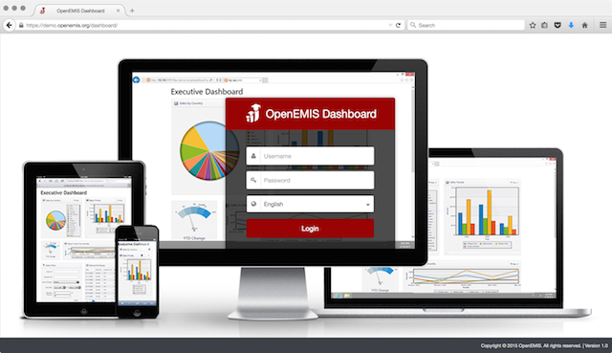
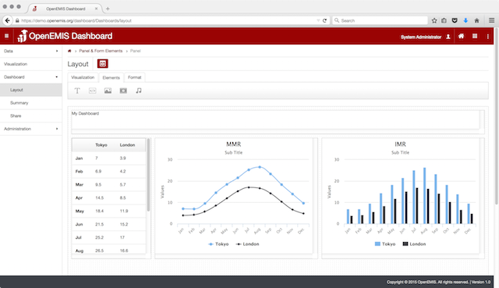
OpenEMIS Dashboard

Slide 20
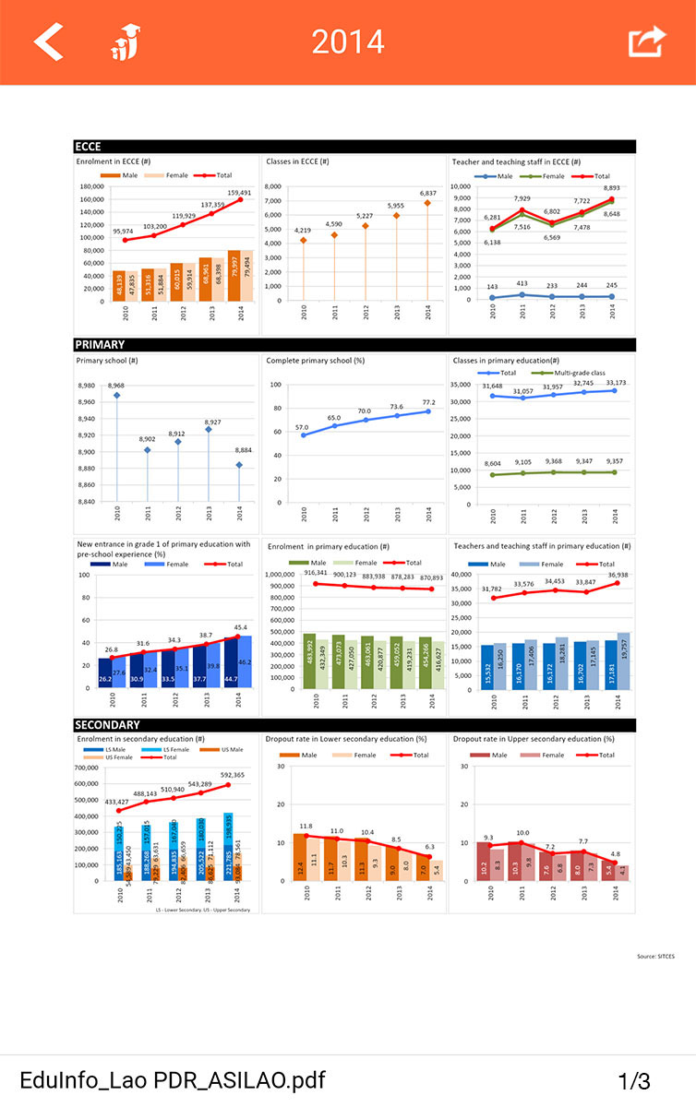
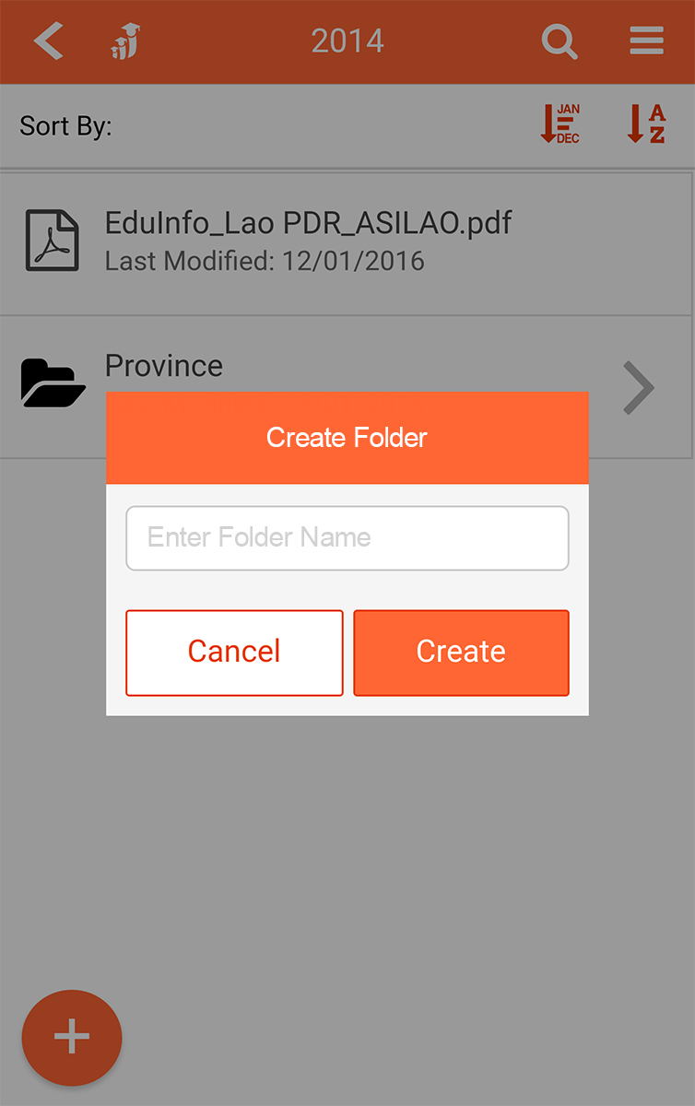
OpenEMIS Profiles

Slide 21
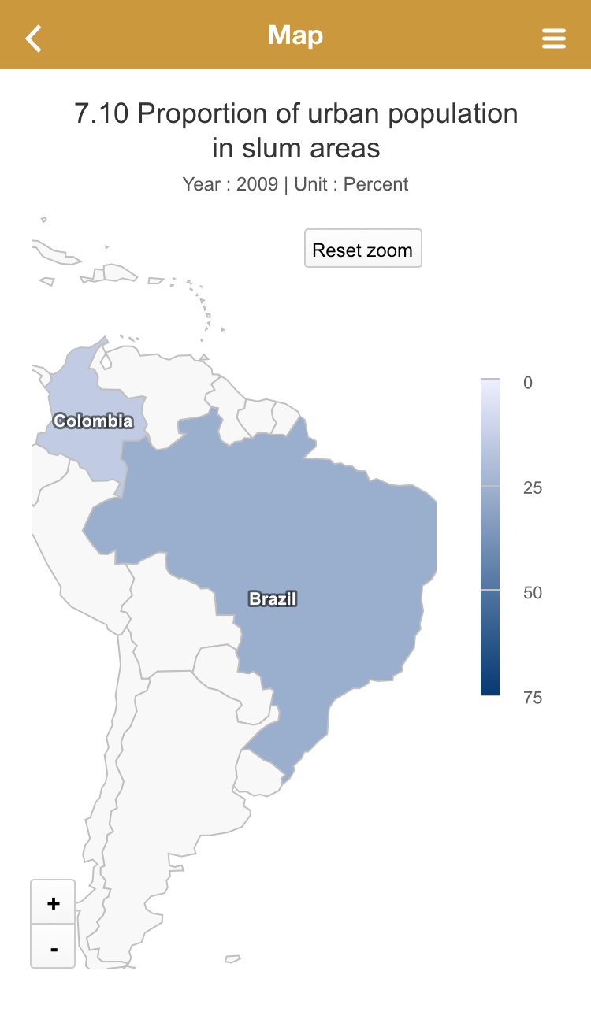
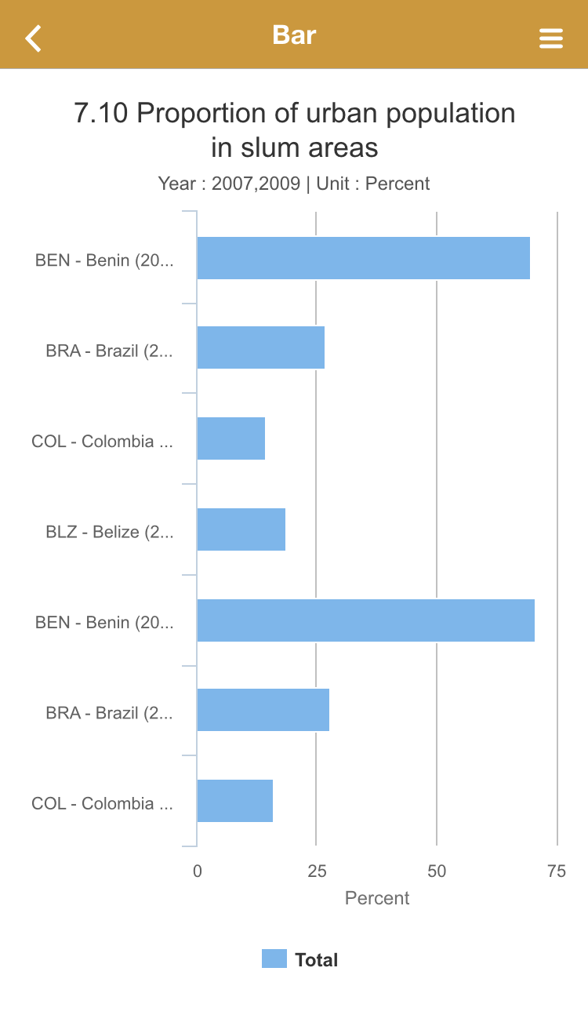
OpenEMIS Visualizer

Slide 22
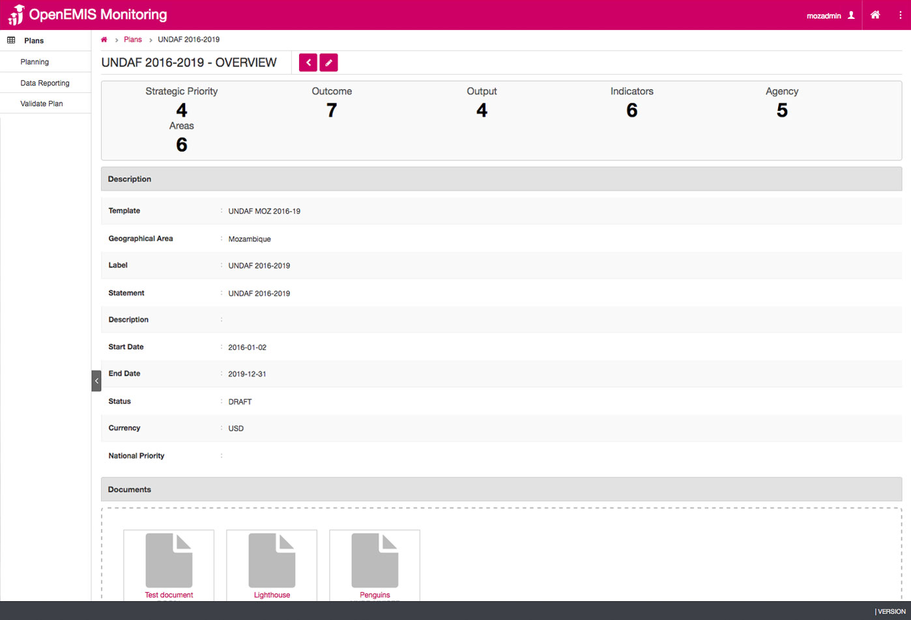
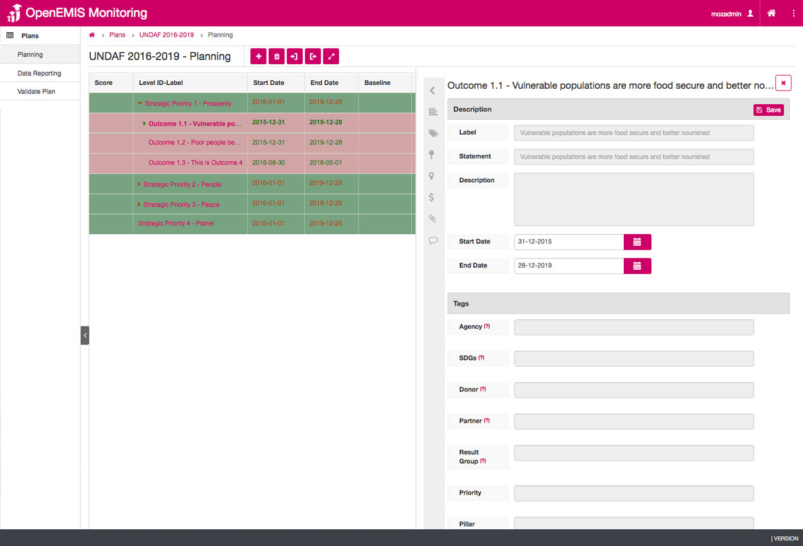
OpenEMIS Monitoring

Slide 23
Data
Analysis
Data
Collection
Data
Management

Slide 24
US$ 16 billion
Notes:
Sixteen billion US dollars per year in aid would send all children to school.
This is about half of the amount Europeans and Americans spend on ice cream annually.
(Source: Worldwatch Institute)

Slide 25
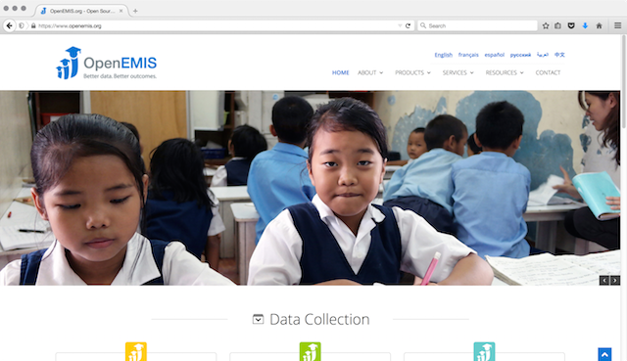
OpenEMIS Website
www.openemis.org

Slide 26
OpenEMIS Facebook
www.facebook.com/openemis

Slide 27
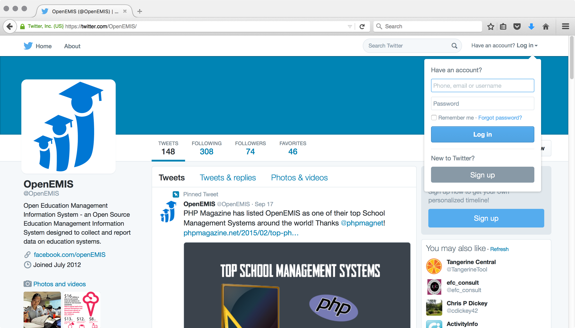
OpenEMIS Twitter
www.twitter.com/openemis

Slide 28
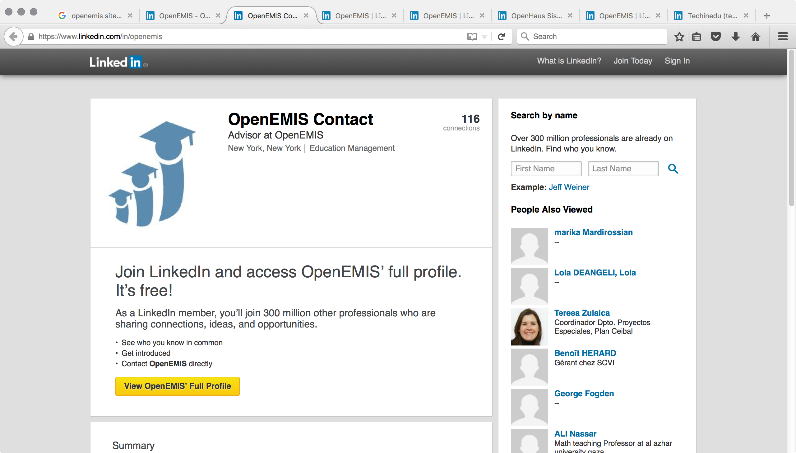
OpenEMIS Linkedin
www.linkedin.com/in/openemis

Slide 29
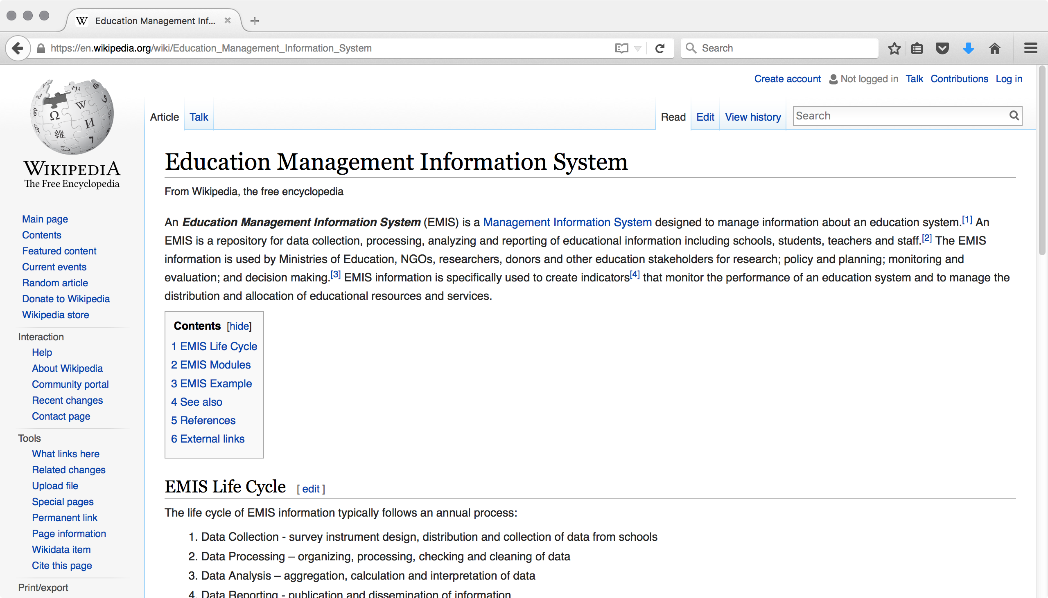
OpenEMIS Wikipedia
en.wikipedia.org/wiki/Education_Management_Information_System

Slide 30
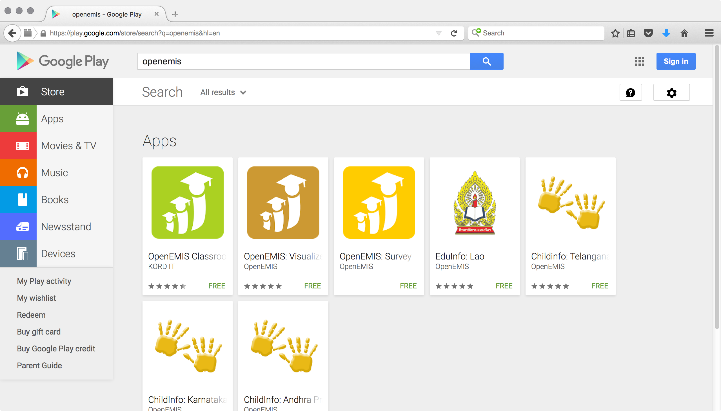
OpenEMIS App Store
play.google.com/store/search?q=openemis

Slide 31
Japanese Proverb
Planning without action is a daydream

Slide 32
Action without planning is a nightmare
Japanese Proverb
Planning without action is a daydream

Slide 33
Policy and Planning Services
Needs Assessment and Gap Analysis
Data Collection Analysis
Policy Development
Project Scoping
Strategic Planning

Slide 34
Implementation Services
Installation and configuration
Data Migration (per system)

Slide 35
Support Services
Annual Application Cloud Hosting
Annual Maintenance and Support

Slide 36
Analytical Services
Business Intelligence
Online Dashboards
Simulation Modeling
Monitoring & Evaluation
Reports & Profiles

Slide 37
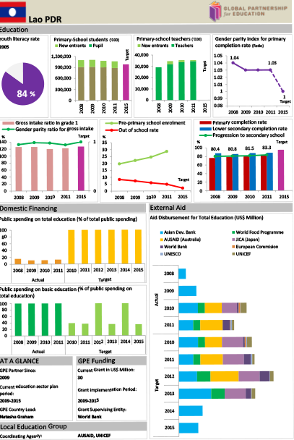

Slide 38
Ad Hoc Services
Data Entry
Data Validation
Digital Mapping
Language Translation
System Integration

Slide 39
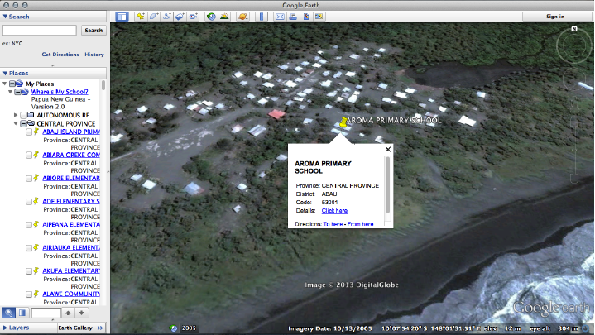
Where’s
My School?

Slide 40
Software Development Services
Custom Reports
Mobile Application
Module Customization
New Feature

Slide 41
Training Services
Professional
Training
Administrator
Training
Analyst
Training
Training of
Trainers
Advanced
Lab Training

Slide 42
Advocacy Materials
Brochure
CD-ROM / USB
Poster
Video
Website

Slide 43
